Slide 1

Team Meeting

Slide 2
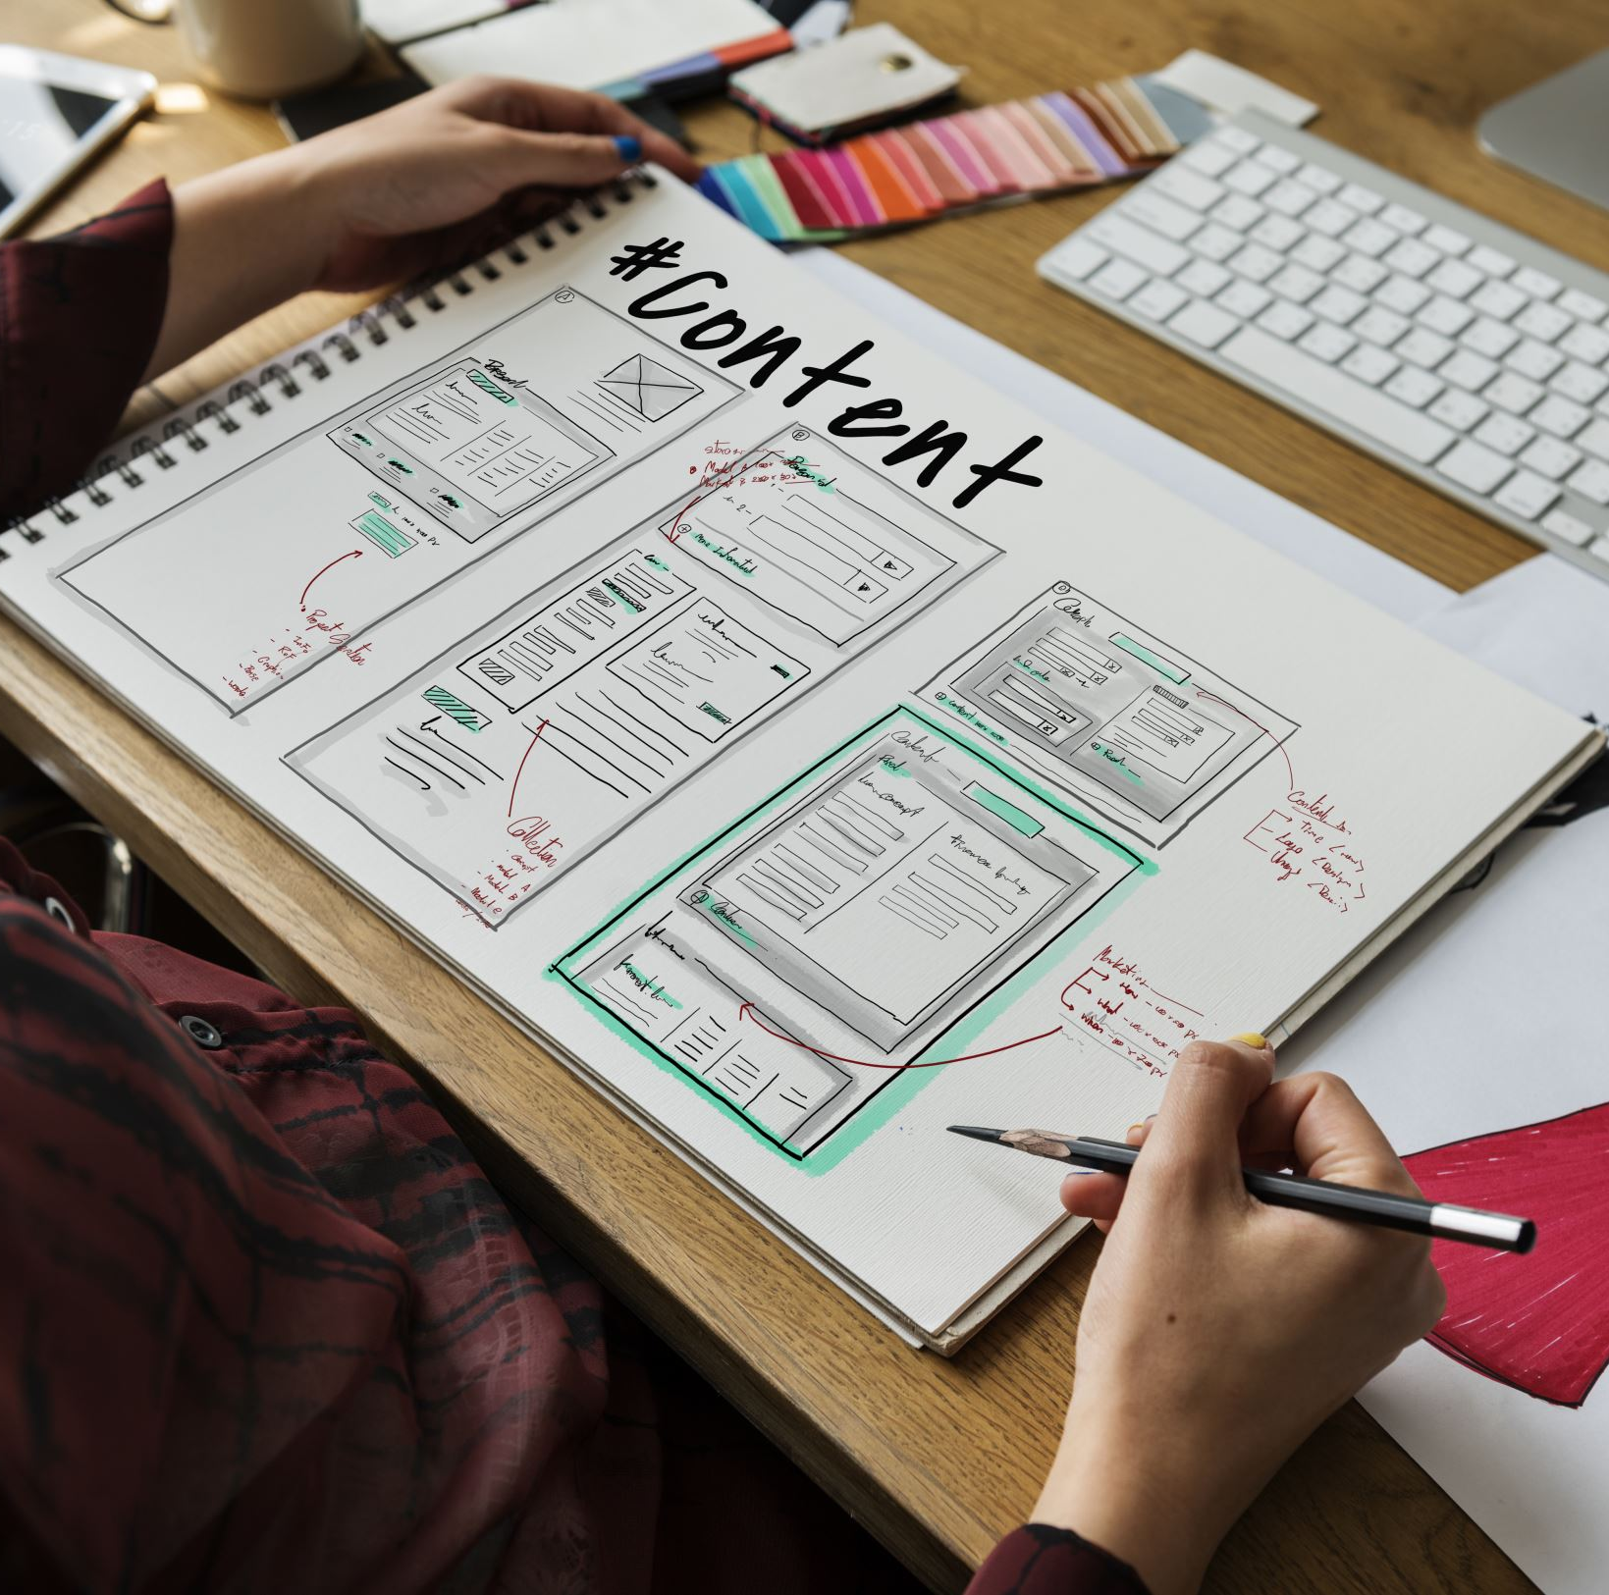
Concerns
New site layout implementation
Administrative features

Slide 3

New Concerns

Slide 4
Retrospective

Slide 5

Things Done Well

Slide 6

Things not done well

